Slide 1
Conceptual Database Design
Adapted from Chapter 16 (Connolly & Begg)

Slide 2
Chapter 16: Objectives
How to use Entity–Relationship (ER) modeling to build a conceptual data model based on the data requirements of an enterprise.
How to validate the resultant conceptual model to ensure it is a true and accurate representation of the data requirements enterprise.
End-users play an integral role throughout the process of conceptual database design.

Slide 3
Database Design Methodology
Three main phases:
Conceptual database design
Logical database design
Physical database design

Slide 4
Conceptual Database Modeling
The process of constructing a model of the data used in an enterprise, independent of all physical considerations.

Slide 5
Conceptual database design
Identify the entity types
Identify the relationship types
Identify the attributes / Identify the attribute domains
Identify the candidate keys and primary key
Apply generalization (is-a), aggregation (has-a), composition (part-of) -Optional Step-
Check model for dependency
Validate conceptual model against user transactions
Review model with user
Covered
Not Covered

Slide 6
Step1: Identify Entities
Identify the nouns in the user requirement specification
Entities should be major objects NOT properties of other objects.
Objects that have existence in their own right
Look for entity types that may be synonyms of each other
Document the synonyms
All entity names should be well descriptive

Slide 7
Step2: Identify Relationships
Identify the verbs in the user requirement specification
Classify relationships as complex, binary or recursive.
Determine the multiplicity of each relationship
Check for fan and chasm traps
Document and assign meaningful names to the relationships

Slide 8
Step3: Identify Attributes
Identify the properties or the qualities of the entity types
Classify each attribute as:
Simple versus composite attribute
Single versus multi-valued attribute
Derived attribute (ensure attribute can be derived from given attributes)

Slide 9
Step4: Identify Candidate & Primary Keys
Identify the candidate keys
Choose the primary key from the candidate keys that are:
Candidate key with the minimal set of attributes
Candidate key that is least likely to be updated
Candidate key with the fewest number of bytes
Candidate key with the lowest maximum value
Candidate key that is easiest to manipulate for a user.
All other candidate keys are designated as alternate keys
Be willing to add new attributes that provide uniqueness if the current candidate keys are composite
Make sure that keys are properly identified for weak entity

Slide 10
Step5: Identify Hierarchical Relationships
Generalization (Is-a) allows us to represent super and subclasses for an entity type.
Participation - all members of the superclass must fall into a subclass {Mandatory | Optional}
Disjoint - subclasses do not share members {And | Or}
Composition (Part-of) allows us to represent an entity type that composes another entity type (strong ownership).
Aggregation (Has-a) allows us to represent an entity type that has a collection of another entity type

Slide 11
Step6: Check Model for Redundancy
Review 1-1 relationships to ensure the entity types are really different entity types and not synonyms.
Remove redundant relationships: relationships that provide the same information as another relationship.
Multiple paths between entity types are a potential source for redundancy
Consider time and its effect on each relationship
Some relationships may seem redundant but really are necessary due to changes in relationships due to time

Slide 12
Step7: Validate Conceptual Model
The conceptual data model must provide a response for all user defined transactions.
If model cannot provide an answer, the conceptual model is not complete.
Two methods that use two different representations of data model:
Textual description of the user transaction
Transaction pathway through the conceptual model to retrieve response for the transaction

Slide 13
Step8: Review conceptual model with user
Must get sign-off from the user that the model capture all necessary data.
Implies user has verified all transactions can be answered

Slide 14
Example: Requirement Specifications
The university is composed of departments. Academic departments (such as the Mathematics and Drama departments) are responsible for offering courses. Non-academic departments (such as the Admissions and Dining Hall departments) are responsible for the other tasks that keep the university running.
Each student in the university has a graduation year, and majors in a particular department. Each year, the students who have not yet graduated enroll in zero or more courses. A course may not be offered in a given year; but if it is offered, it can have one or more sections, each of which is taught by a professor. A student enrolls in a particular section of each desired course

Slide 15
Example: Requirement Specifications
Each student is allowed to have one car on campus. In order to park on campus, the student must request a parking permit from the Campus Security department. To avoid misuse, a parking permit lists the license plate and model of the car. The database should:
allow students to declare and change major department;
keep track of parking permits;
allow departments, at the beginning of each year, specify how many sections of each course are offered for that year, and who will teach each section;
allow current students to enroll in sections each year;
allow professors to assign grades to students in their sections

Slide 16
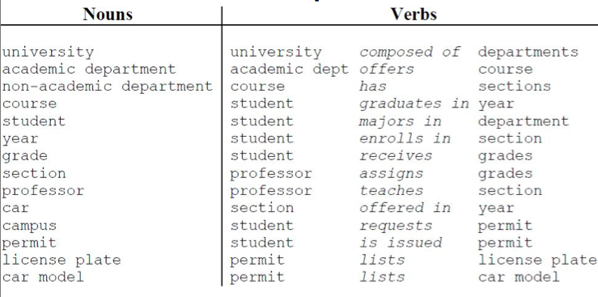
Identifying Entities, Attributes, and Relationships
Notes:
Extract relevant concepts from requirements spec
• Nouns describe entities
• Verbs describe relationships between entities

Slide 17
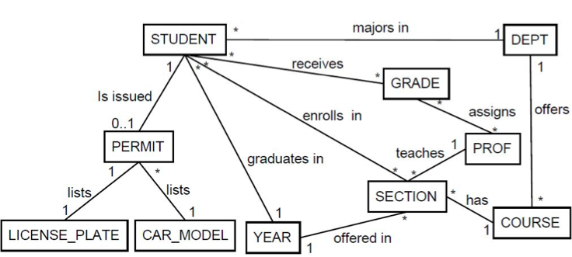
Preliminary Diagram
Revised list of nouns and verbs yield initial diagram:

Slide 18
Inadequate Relationships
Relationships describe how entities connect
From STUDENT record we can follow relationships
majors in to get to corresponding DEPT entity
enrolls in to get all SECTION entities
enrolls in and has to get all COURSE entities
What if we had chosen STUDENT enrolls in COURSE ?
Make sure relationships convey intended meaning

Slide 19
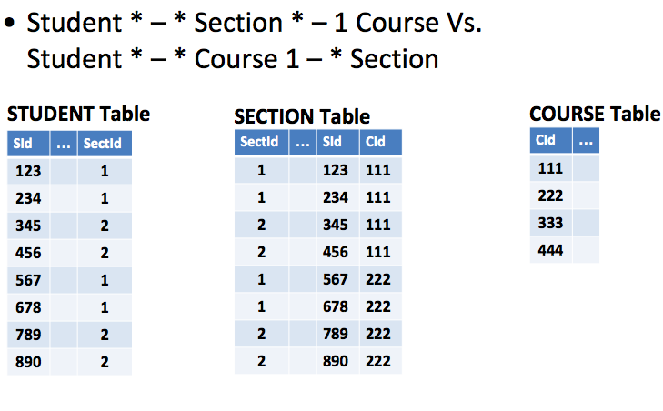

Slide 20
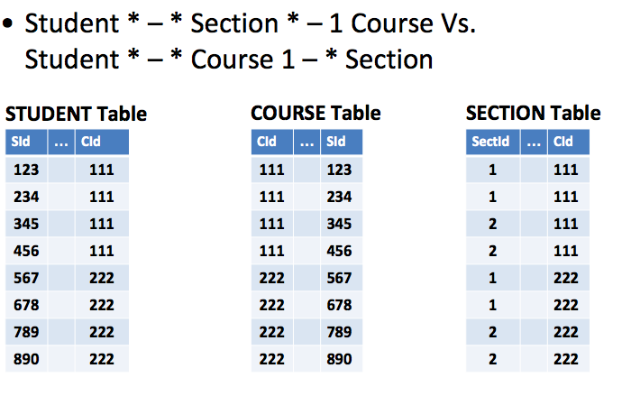

Slide 21
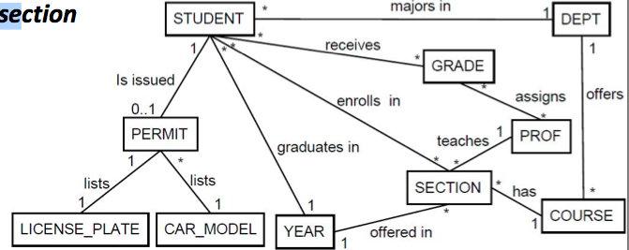
Inadequate Relationships
Exhaustively consider every path
Make sure diagram captures desired information
A couple more inadequate relationships:
– receives captures grade for each student but not section
– assigns captures grades prof gave but no student or

Slide 22
Inadequate Relationships
This happened because we oversimplified requirement spec interpretation
– “student receives grades”
• “student receives grade for an enrolled section” – “professor assigns grade”
• “professors to assign grades to students in their section

Slide 23

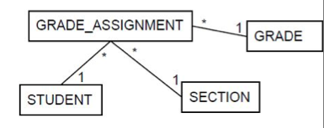
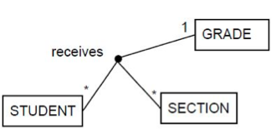
Relationships involving >= 2 entities
Involve three or more entities, (>2 nouns) e.g.:
– “student receives a grade for an enrolled section”
– “professor assigns grade to student in section”
Consider
Two ways to represent multi-way relationships

Slide 24
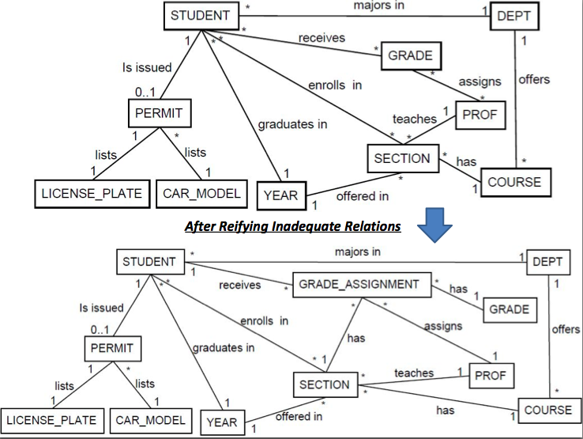

Slide 25
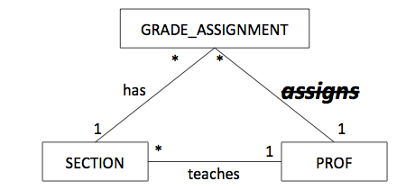
Redundant Relationships
The assigns relationship is also redundant
• Describes who assigned each grade
• But PROF assigns all the grades of a SECTION
• We know PROF of each SECTION
• Don’t need each assignment, just PROF of section

Slide 26
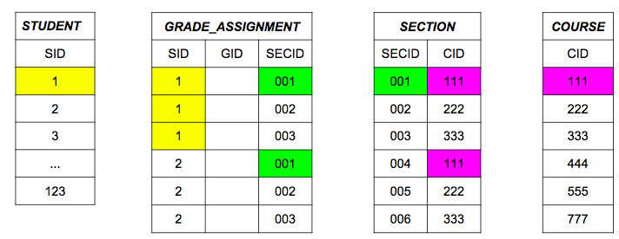
Redundant Relationships
“all sections a student is enrolled in” STUDENT -- enrolls in -- SECTION
Redundant with STUDENT -- GRADE_ASSIGNMENT -- SECTION

Slide 27
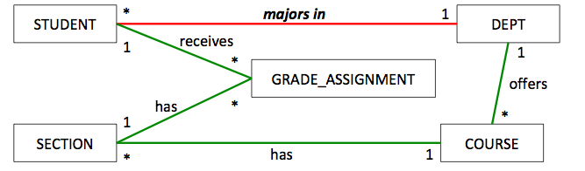
Check All Relationships for Redundancy
Consider relationship majors in
Check redundancy with STUDENT, GRADE_ASSIGNMENT, SECTION, COURSE, DEPT
But this path describes the DEPT, offering the COURSE, as opposed to the STUDENT’s major
So, majors in is not redundant

Slide 28
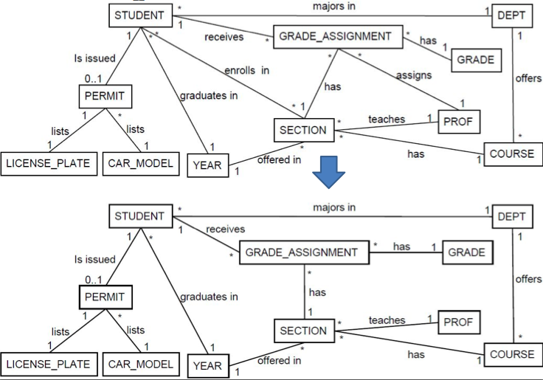

Slide 29
Entities vs. Attributes
Depending on the domain, a noun can be an entity or an attribute
Consider a professor
– Attribute if we only care about the name as part of a course
– Entity If we need to maintain an official list of professors
Same thing for departments
– If we want to keep track of all departments, it’s an entity
Represent a noun as a class if we want to keep an explicit list of its entities

Slide 30
Entities vs. Attributes
All nouns can’t be entities.
Nouns for real life entities are “classes”, e.g., student
Nouns for values are attributes, e.g., year
But it really depends on the level of abstraction we choose
Consider a license plate
– Do we just care about the value of plate (attribute)
– Or do we care about several aspects, i.e., state, design, physical condition (entity)

Slide 31
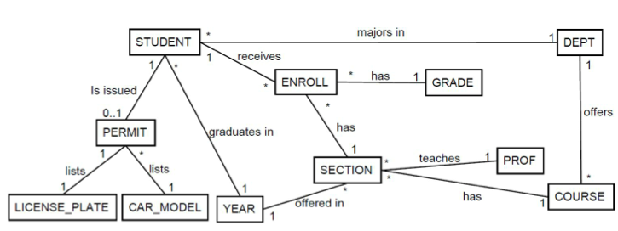
Entities vs. Attributes
Let’s convert the following entities to attributes
GRADE , PROF , YEAR , LICENSE_PLATE , CAR_MODEL

Slide 32
Deriving Attributes
GRADE is only related to ENROLL
We add grade to ENROLL and remove the GRADE entity
PROF is only related to SECTION
We add prof to SECTION and remove the PROF entity
LICENSE_PLATE & CAR_MODEL are only related to PERMIT
We add licensePlate and carModel to PERMIT and remove those entities
YEAR related to both STUDENT and SECTION
We add year to both entities and remove the YEAR entity

Slide 33
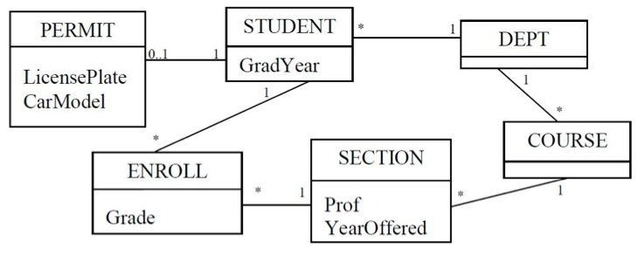
Entities vs. Attributes
After converting the following entites to attributes:
GRADE, PROF, YEAR, LICENSE_PLATE, CAR_MODEL

Slide 34
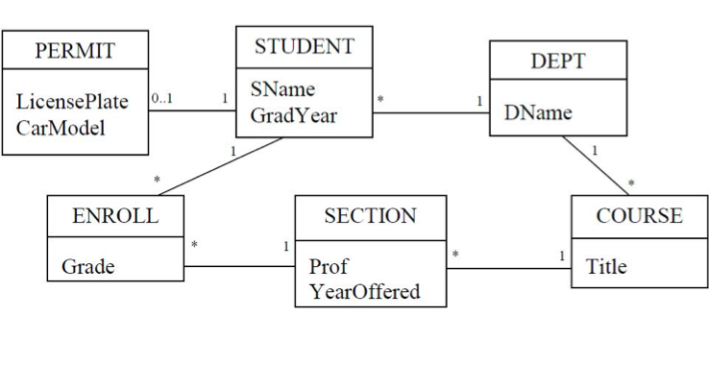
Adding Additional Attributes
Often requirements are incomplete and do not contain necessary entities or attributes
Obvious attributes + Assumed attributes

Slide 35
Another Example
Vehicles may be parked in a garage. Every garage has an address. Some vehicles are cars, and some are boats. Every vehicle has a unique vin (vehicle identification number) and a power rating (in horsepower). A vehicle has an owner. A car has a number of tires. A boat has a number of propellers and may have a name.

Slide 36
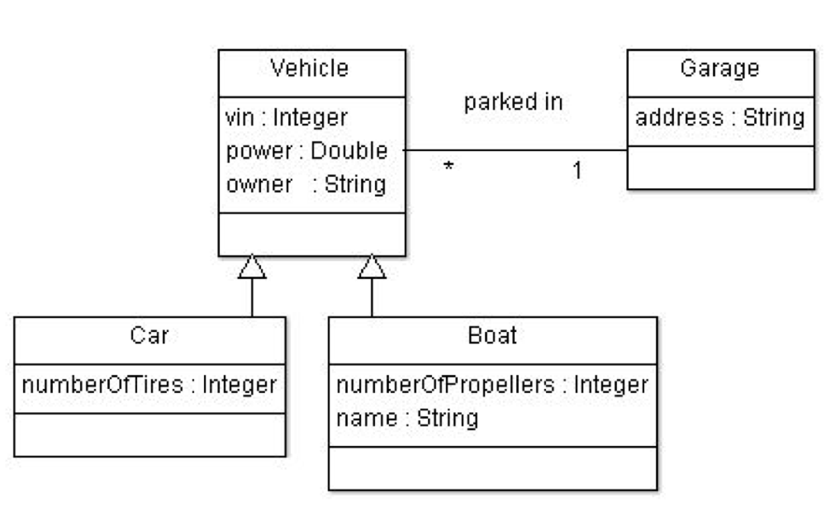
Design

Slide 37
Critical Success Factors in Database Design
Work interactively with the users as much as possible.
Follow a structured methodology throughout the data modeling process.
Incorporate structural and integrity considerations into the data models.
Combine conceptualization, normalization, and transaction validation techniques into the data modeling methodology.
Use diagrams to represent as much of the data models as possible.
Be willing to repeat steps.

